Slide 1
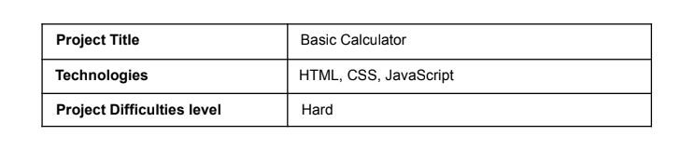
PROJECT 1(BASIC) -BASIC CALCULATOR
-SUBMITTED BY
POOJA V K

Slide 2
Introduction :
In this project, we leverage the power of HTML and CSS to create a simple functional calculator. Our goal is to demonstrate the potential of these technologies in building interactive web applications. The calculator is designed to be user-friendly, with a straightforward interface that allows users to perform basic arithmetic operations with ease. By utilizing HTML for structuring content and CSS for styling and layout, we have created a calculator that is both functional and visually appealing. This project serves as a testament to the capabilities of HTML and CSS in building web applications that are both practical and aesthetically pleasing.

Slide 3
Objectives :
To create a user-friendly interface for a calculator.
To implement basic arithmetic operations.
To practice front-end development skills.

Slide 4
Tools and Technologies Used
The project was implemented using the following technologies:
HTML5 for structuring the content
CSS3 for styling the layout and appearance
JavaScript for handling user input and performing arithmetic operations
The project was developed using a code editor and tested on multiple browsers to ensure compatibility.

Slide 5
Design and Implementation:
HTML:
The HTML file contains a div element to act as the calculator's container.
Inside the container, there is an input element for the display and multiple button elements for the calculator keys.
CSS:
The CSS file styles the calculator to look like a traditional handheld device.
It includes grid layout for button placement, font styles, colors, and responsive design for different screen sizes.
JavaScript:
JavaScript is used to capture button clicks and perform calculations.
It updates the display with the user's input and the result of the operations.
It includes functions to handle the logic of each operation and to evaluate the mathematical expression entered by the user.

Slide 6
Project Features:
A display screen to show the current input and calculation result.
Buttons for digits (0-9), operations (+, -, *, /), and a decimal point.
A clear button (C) to reset the current operation.
An equals button (=) to compute the result.

Slide 7
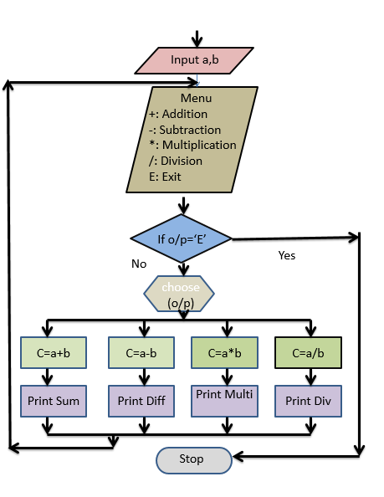
Flow diagram

Slide 8
OUTPUT SCREEN:
Explanation:
HTML Structure:
Head Section: Contains meta tags, title, and embedded CSS for styling the calculator.
Body Section: Contains the calculator interface within a .container div. The .calculator div holds the input field for displaying calculations
and buttons for digits, operators, and other functionalities.
History Section: Includes a button to toggle the visibility of the history section and a .history div to display the list of past calculations.
CSS Styling:
Ensures the calculator is centered on the screen with a clean, modern look.
Buttons change color when hovered to indicate interactivity, and different types of buttons (e.g., operators, all-clear) have distinct styles for
clarity.
JavaScript Functionality:
Initializes the calculator state and updates the display and history based on user interactions.
Functions handle digit input, operator input, backspace functionality, and resetting the calculator.
The history feature stores calculations in localStorage and updates the display accordingly.
The toggleHistory function toggles the visibility of the history section when the history button is clicked.
Key Features:
Display Update: Updates the calculator screen with the current value.
History Update: Manages the history of calculations, saving to and loading from localStorage.
Digit and Operator Handling: Manages input from the user and performs calculations.
Backspace and Clear Functions: Allows the user to correct or reset their input.
History Toggle: Toggles the visibility of the history section to view past calculations.

Slide 9
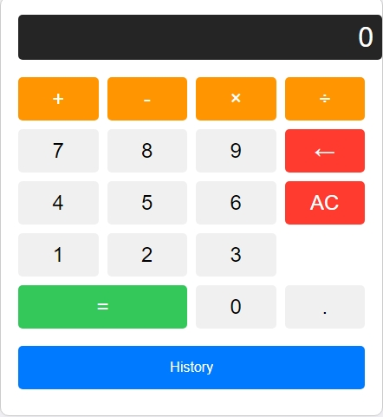
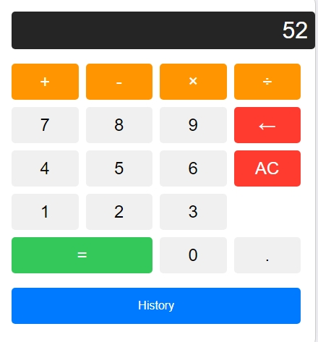
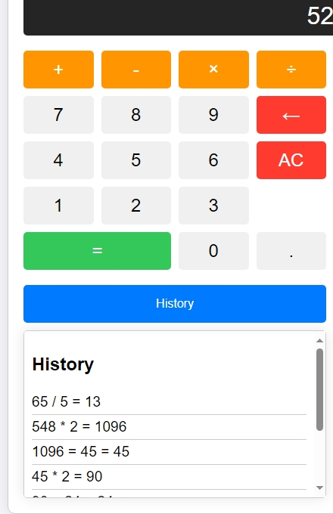
STEP 1:
STEP 2:
STEP 3:

Slide 10
Conclusion :
In this project, we successfully created a basic calculator web application using HTML and CSS. Our calculator demonstrates the fundamental capabilities of these technologies in building interactive web applications. Through this project, we showcased the potential of HTML and CSS in designing and developing functional and visually appealing interfaces. This calculator serves as a foundation for further development and integration of advanced features, highlighting the vast possibilities in web application development. Our project demonstrates that even simple projects can showcase the power and versatility of HTML and CSS, making them an excellent starting point for future web development endeavors.

